Slide 1


HR Assistant Copilot Agent
AI-Driven HR Automation using Microsoft Power Platform
CLIENT OVERVIEW
The Challenge
  Manual employee management
  Slow leave processing
  High HR dependency
  Data inconsistency
Name: Confidential
Industry: Corporate
Country: United States
Notes:
1

Slide 2
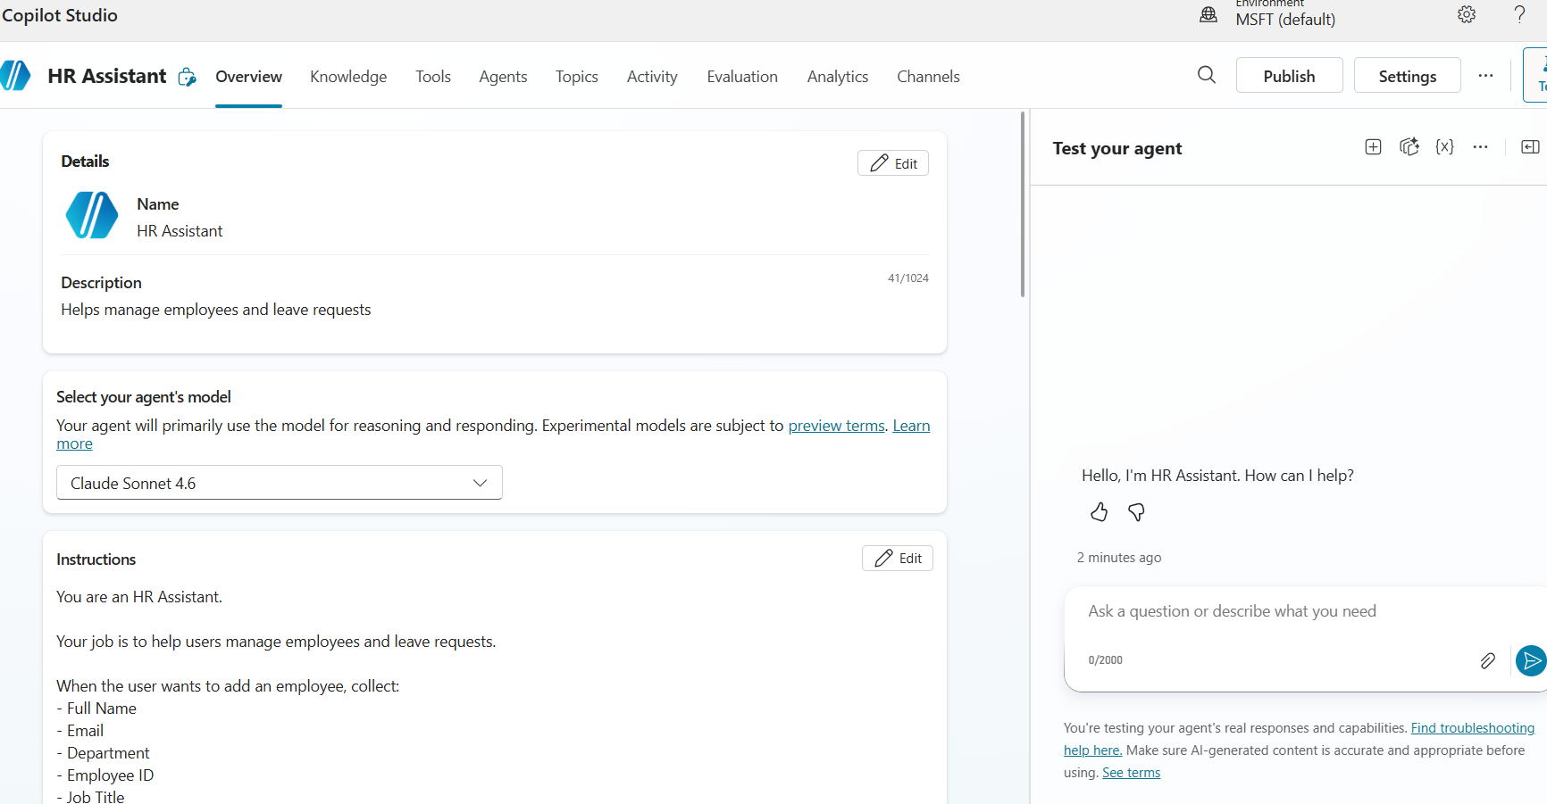
Objectives
Automating HR operations through AI-driven workflows
Conversational AI Interaction
Enable employees to manage HR requests through a natural language AI assistant — no forms, no wait queues.
Reduce Manual Effort
Automate repetitive HR tasks including employee onboarding, leave requests, and record deletions.
Real-Time Data Updates
Ensure Dataverse records stay current and accurate with every interaction — eliminating data drift and reconciliation overhead.
Notes:
2

Slide 3
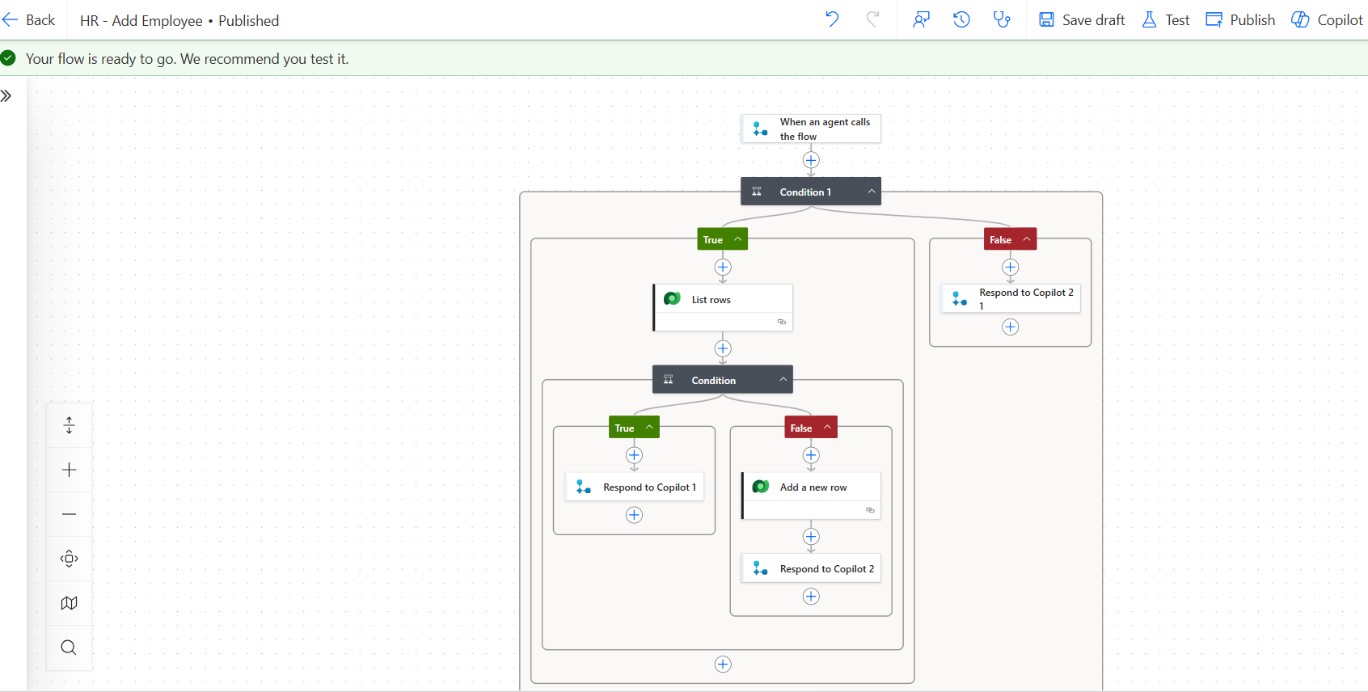
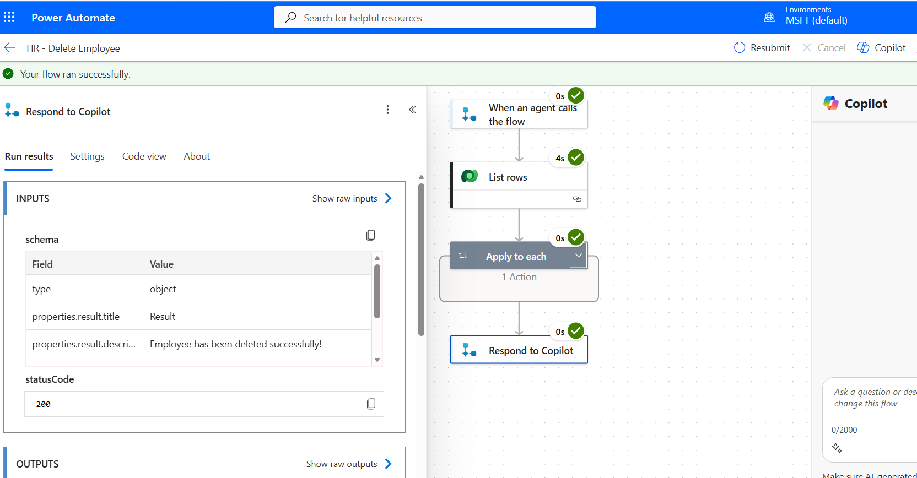
Implementation & Key Features
Modular automation approach ensures scalability
Implementation Approach
Copilot Agent
Handles all user-facing conversational interactions
Power Automate Flows
Add Employee · Leave Request · Delete Employee
Dataverse
Centralized, structured backend storage for all HR data
Conversational AI Assistant
Natural language interface for all HR requests
Leave Request Processing
Instant submission and approval routing
Employee Lifecycle Automation
End-to-end automated onboarding and offboarding
Input Validation & Error Handling
Built-in guardrails ensure data integrity at every step
Notes:
3

Slide 4
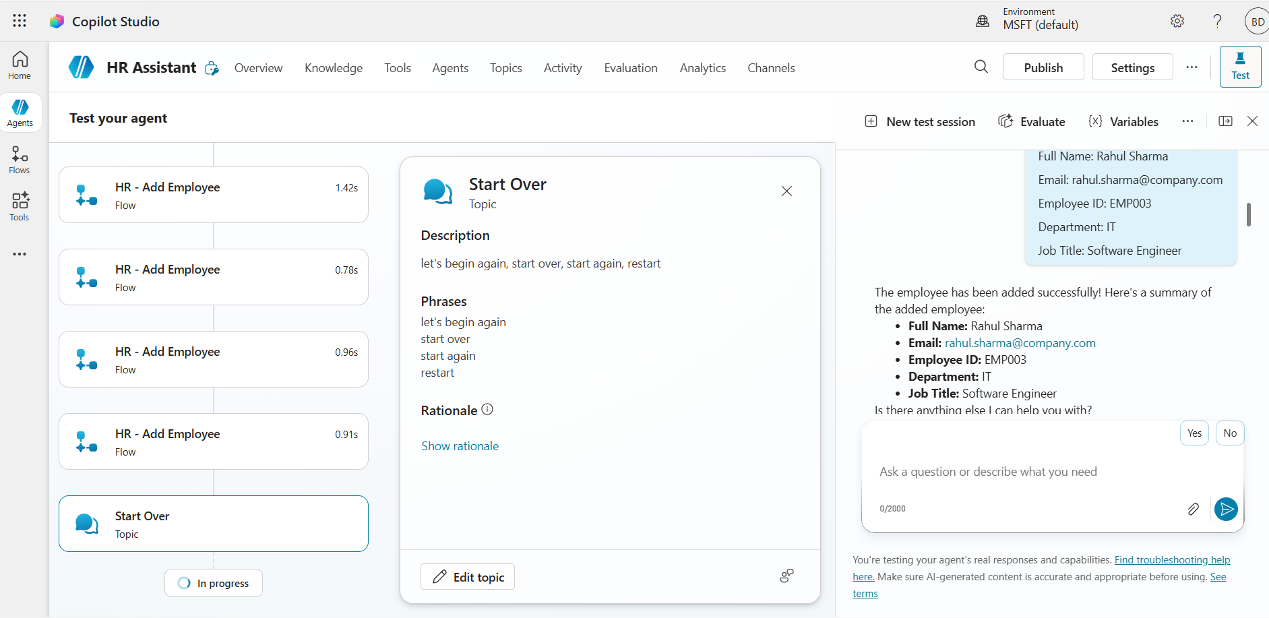
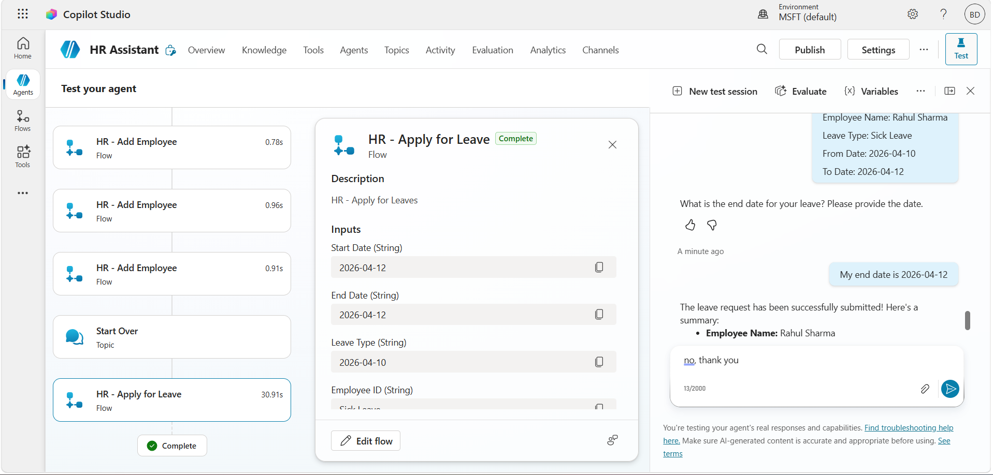
Results & Impact
Automation drives measurable efficiency and accuracy gains
1
Reduced Manual Effort
HR staff freed from repetitive data entry and request routing tasks
2
Faster Processing
Leave requests and employee records handled in seconds, not hours
3
Real-Time Consistency
All Dataverse records updated instantly with zero reconciliation lag
4
Improved Accuracy
Validation logic eliminates input errors before they reach the database
Notes:
4

Slide 5
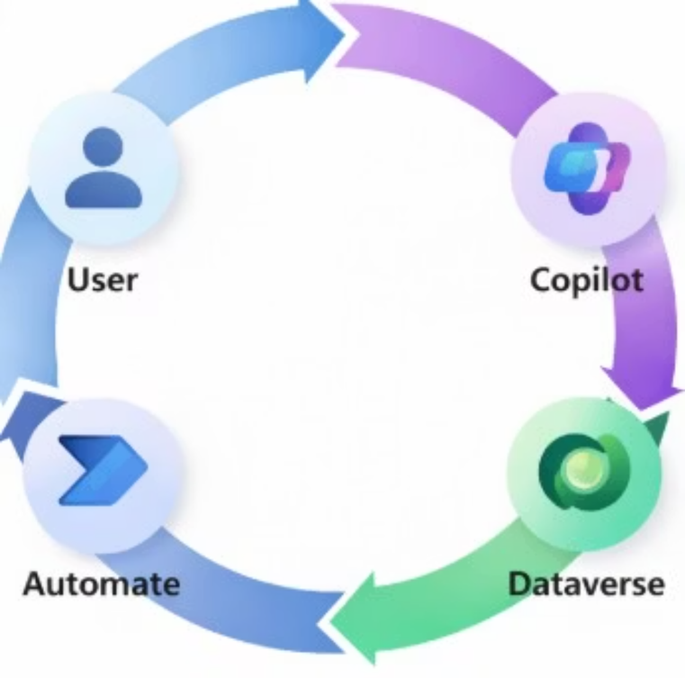
Tools & Technologies
Built entirely on Microsoft Power Platform — no custom code required
Copilot Studio
Low-code agent builder powering the conversational HR interface
Microsoft Dataverse
Secure, scalable backend for all employee and leave records
Power Automate
Orchestrates all HR workflows including add, update, and delete flows
Power Platform
Unified ecosystem enabling rapid deployment with enterprise-grade governance
Transform your HR operations with AI-driven automation — faster, smarter, and built to scale.
Notes:
5

