Slide 1
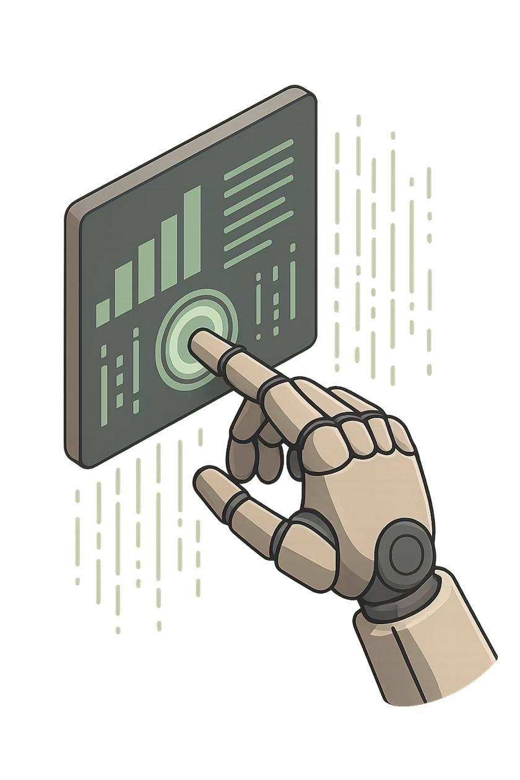
AI-Powered Task Automation using Copilot in Power Apps
Transforming Manual Workflows into Intelligent Automation
Notes:
1

Slide 2

Client Overview
Organization
Process
Mid-sized IT company managing multiple projects
Fully manual task management across projects
Key Issue
High dependency on manual work creating bottlenecks
Client Name: Confidential
Client Country: USA
Client City: Texas
Notes:
2

Slide 3

Problem Statement
Time-Consuming
Manual task creation consumes significant time across projects
No Automation
Lack of automation in workflows leads to high dependency on human input
Inconsistent Structure
Inconsistent task structure across projects
Notes:
3

Slide 4
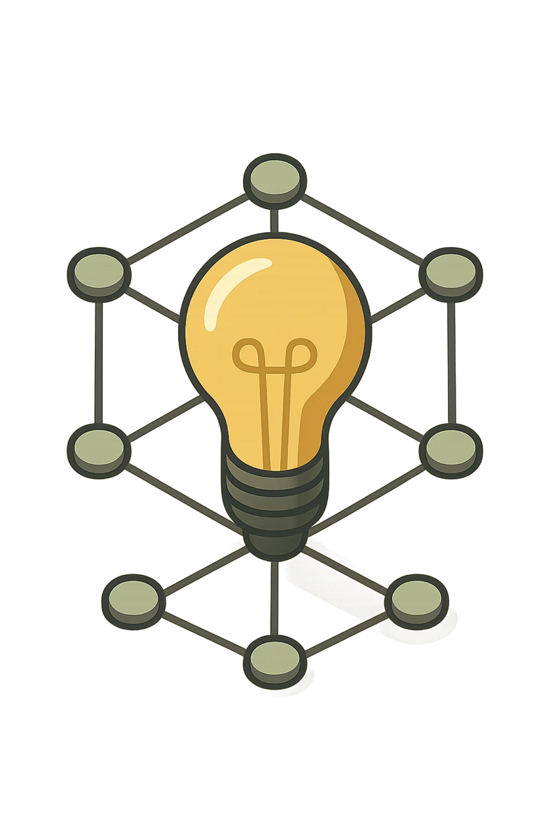

Objectives
Automate Task Creation
Eliminate manual effort with AI-driven task generation
Natural Language Input
Enable users to create tasks using plain language
Structured Data in Dataverse
Store all task data reliably in Microsoft Dataverse
Dynamic UI Updates
Reflect changes in real time within Power Apps
Notes:
4

Slide 5

Solution Architecture
User Input
Copilot Agent
Agent Flow
Dataverse
Copilot processes user input, the Agent Flow handles logic and validation, Dataverse stores structured data, and Power Apps updates the UI dynamically.
Notes:
5

Slide 6
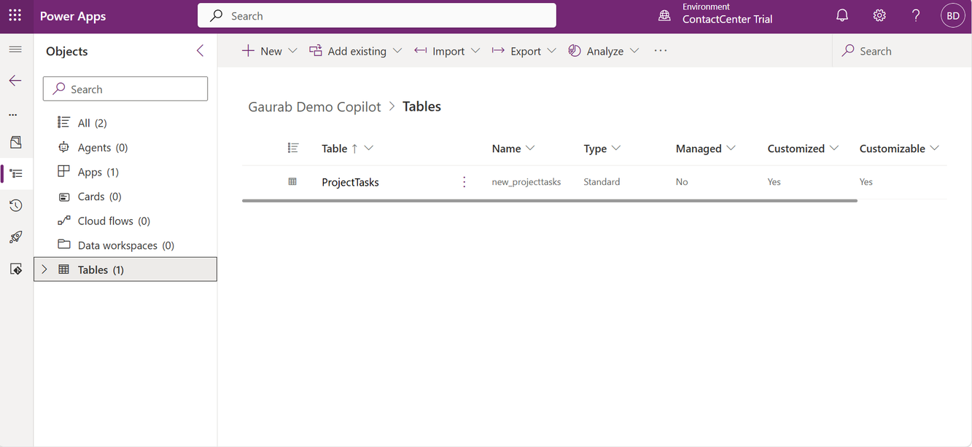
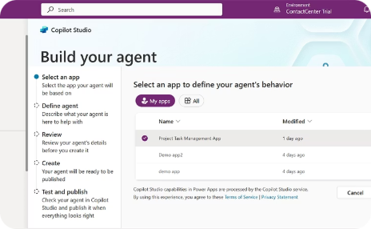
Implementation Approach
Data Setup
Copilot Agent Development
Notes:
6

Slide 7
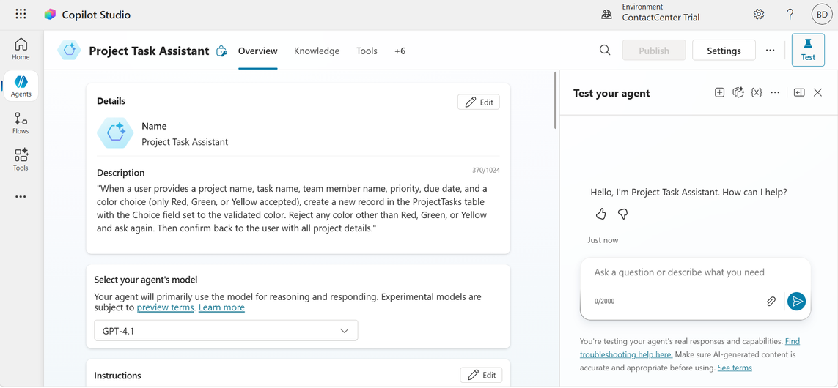
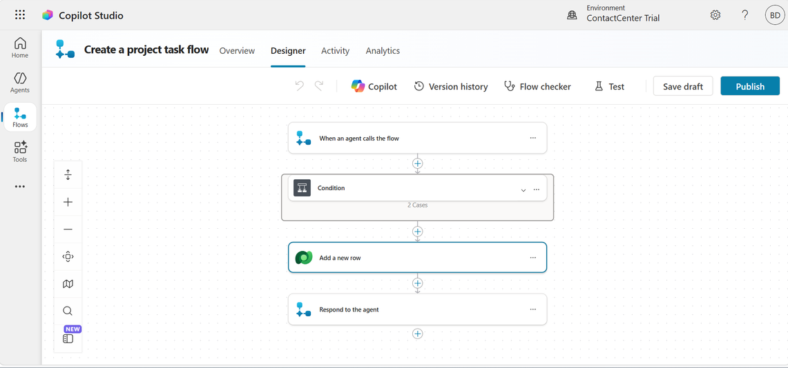
Implementation Approach
Agent Flow with validation logic
Copilot Agent
Notes:
7

Slide 8
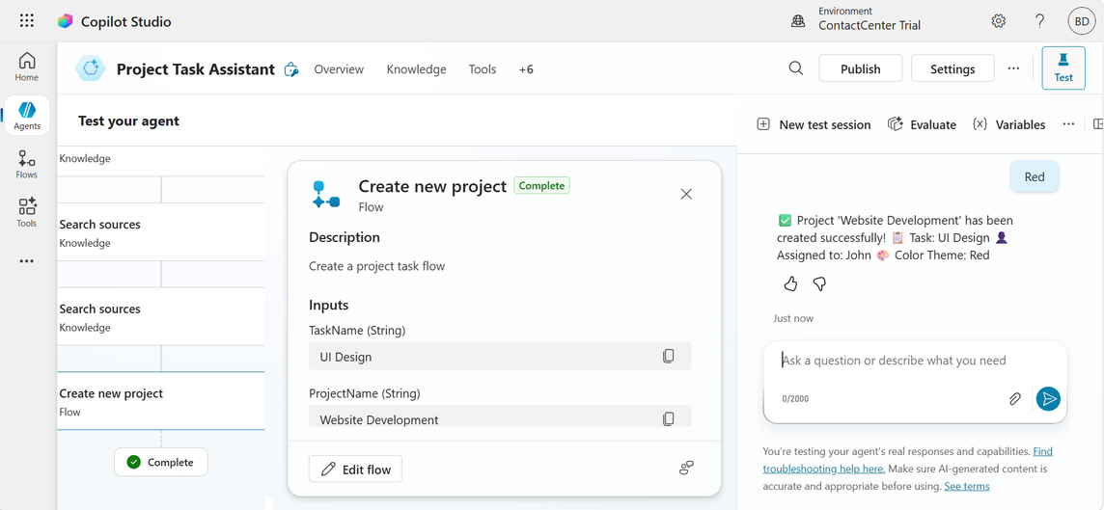
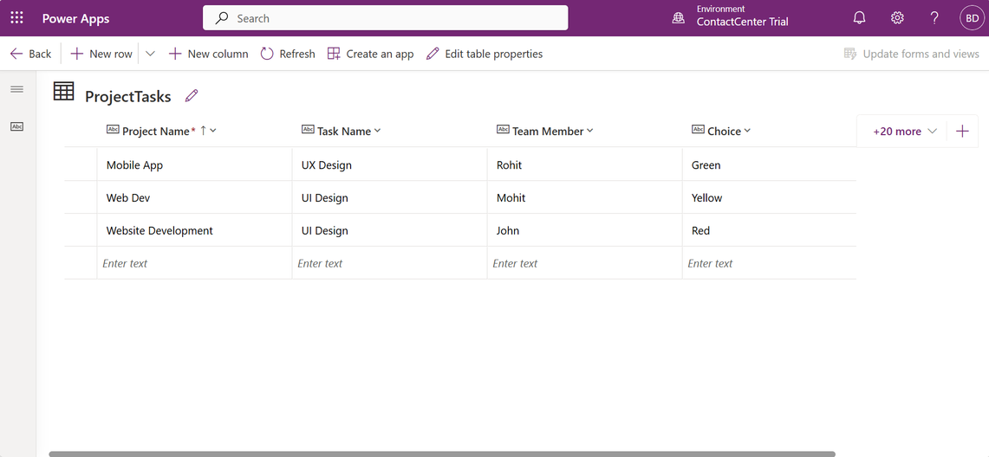
Implementation Approach
Testing Real-time validation & output
Data stored and validated
Notes:
8

Slide 9
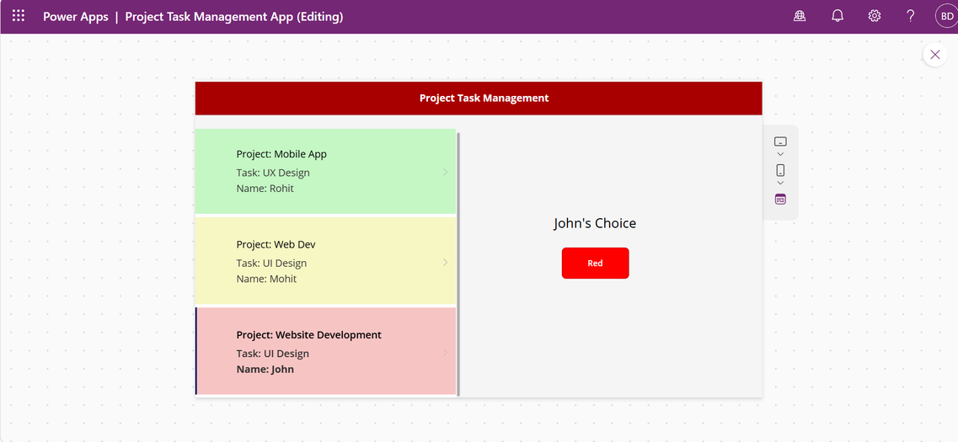
Implementation Approach
Task created successfully
Notes:
9

Slide 10
Key Features
Natural Language Processing
AI Task Generation
Real-Time UI Updates
Automatically creates structured tasks from user input
Understands plain English commands and requests
Interface reflects changes instantly without refresh
Data Validation
Seamless Integration
Ensures data integrity before storage in Dataverse
Copilot, Power Apps, and Dataverse work as one system
Notes:
10

Slide 11

Results & Impact
Reduced Manual Effort
AI handles task creation, freeing teams for higher-value work
Faster Task Creation
Natural language input speeds up the entire process
Improved Data Accuracy
Structured validation reduces human errors
Real-Time UI Updates
Dynamic interface keeps users informed instantly
Better User Experience
Streamlined, intuitive workflow for all users
Notes:
11

Slide 12
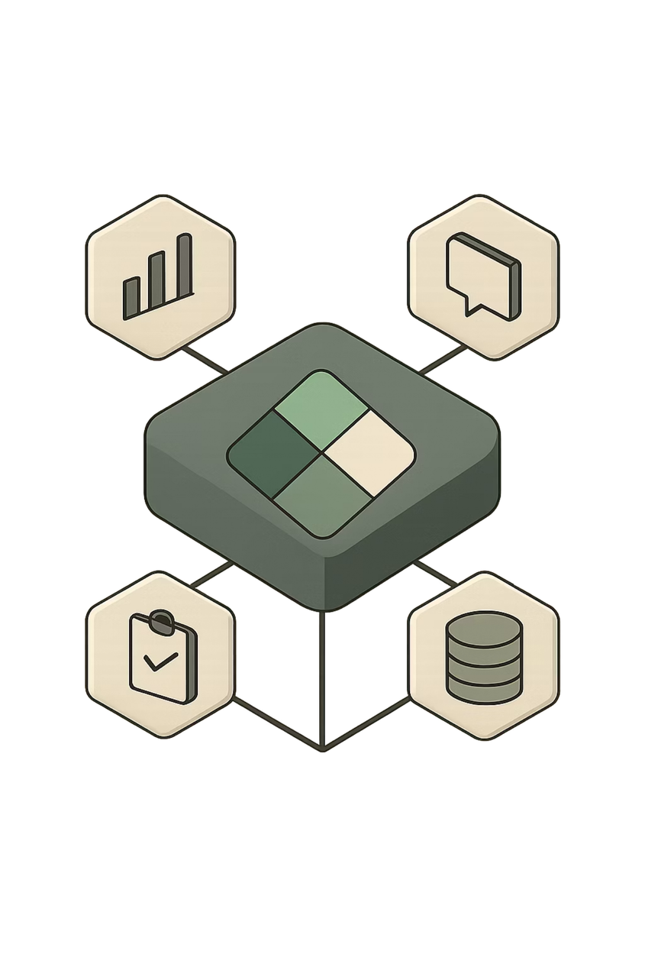
Tools & Technologies
Microsoft Power Apps
Canvas app for building the custom UI and user experience
Microsoft Copilot Studio
AI agent for natural language understanding and automation
Microsoft Dataverse
Secure, scalable data storage for structured task records
Power Platform
Unified low-code platform connecting all components seamlessly
Notes:
12

Slide 13
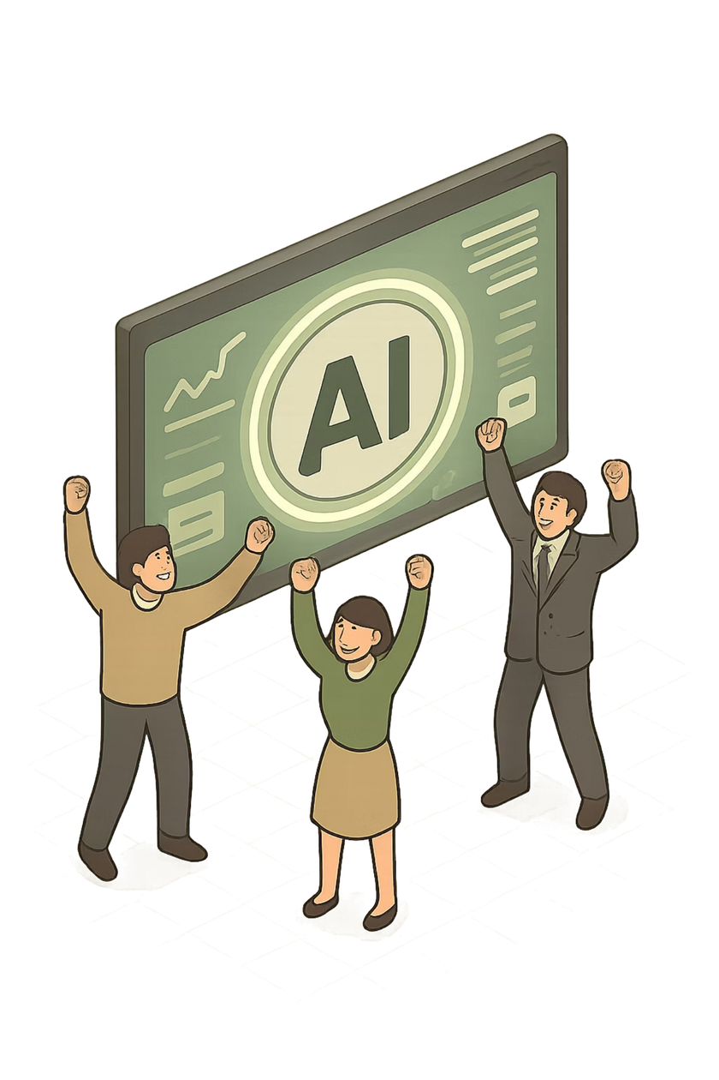
Let's Build Intelligent Solutions with AI
AI-powered Copilot improves efficiency and automation — transforming how teams manage work.
The Outcome
A fully automated, AI-driven task management system built on Microsoft Power Platform
The Vision
Scale intelligent automation across every workflow in your organization
Data stored and validated
Notes:
13

